Slide 1
LIGHT: REFLECTION AND REFRACTION
Light is a form of energy
It is the visible part of the electromagnetic spectrum
It is propagated through transparent materials such as water and glass, although at a lower speed than in vacuum

Slide 2
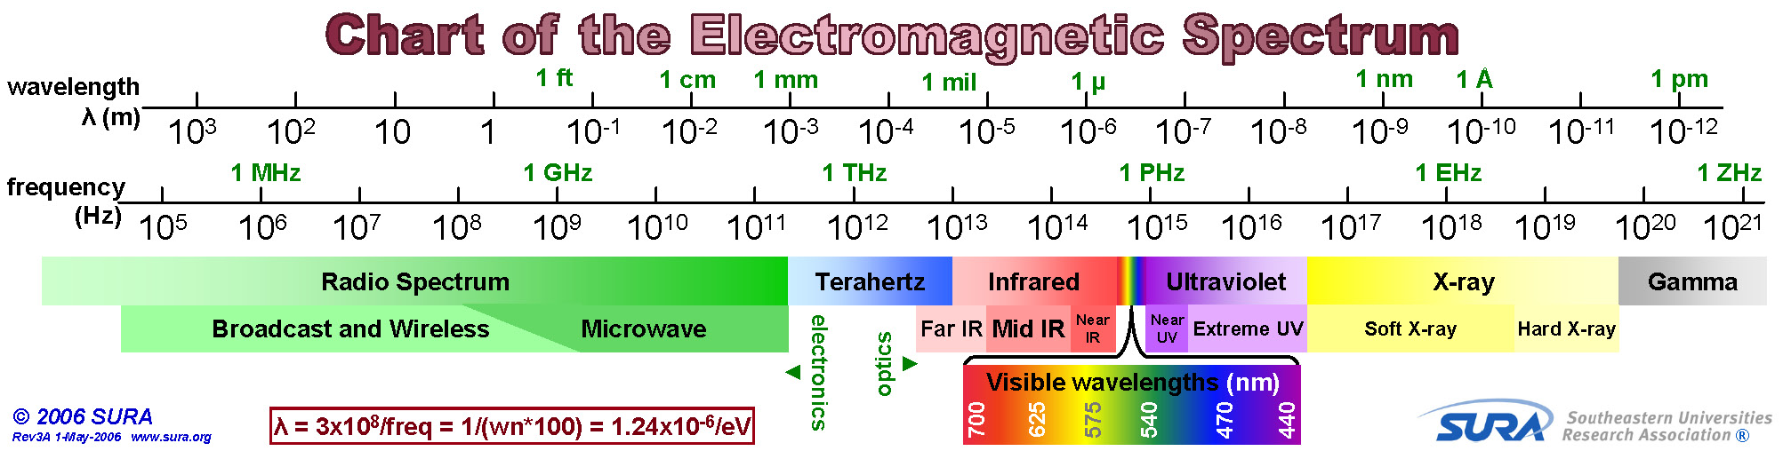
Wavelength of visible light is from 400 nm (violet) to 700 nm (red)

Slide 3
RAY AND BEAM OF LIGHT
Light very often travels in straight lines. We represent light using rays, which are straight lines emanating from an object.
A ray of Light is a line drawn in the direction of propagation of light with an arrow to show the direction
In vacuum or in uniform medium, ray is a straight line.
If the medium is not uniform (for example at a surface), ray can be
curved or bent.
Rays bend at the interface between two dissimilar media and may be
curved in a medium in which the refractive index changes.
Beam of Light is a group of rays of light emitted by a source of light.

Slide 4
REFLECTION
Light striking a surface may be reflected, transmitted, or absorbed.
Reflection is the throwing back of light ray when it strikes an obstacle. The nature of the surface of the obstacle determines the type of reflection that occurs.
TYPES OF REFLECTION
Regular Reflection: This is the reflection that occurs when light strikes a smooth or plane surface like a mirror. In this case, a parallel beam of light is reflected in one direction.
Diffuse Reflection: This is the reflection that occurs when light strikes a rough surface (non- mirror like surface, such as clothing material or a sheet of paper). Here, a parallel beam of light is in all different directions.

Slide 5
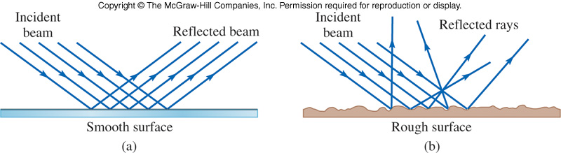
(a) Regular or Specular Reflection (b) Diffuse Reflection

Slide 6
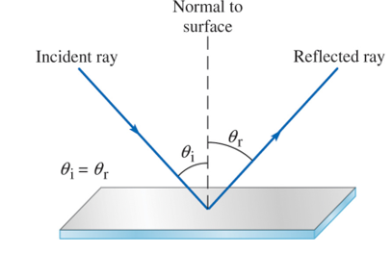
THE LAWS OF REFLECTION
The incident ray, the reflected ray and the normal are all in the same plane
2. The angle of incidence is equal to the angle of reflection θ_{i} = θ_{r}

Slide 7
REFLECTION AT PLANE SURFACES
A mirror is a highly reflecting, optically smooth surface, e.g a highly polished silver surface
A plane mirror is a plane reflecting surface
Image Formation by a Plane Mirror

Slide 8
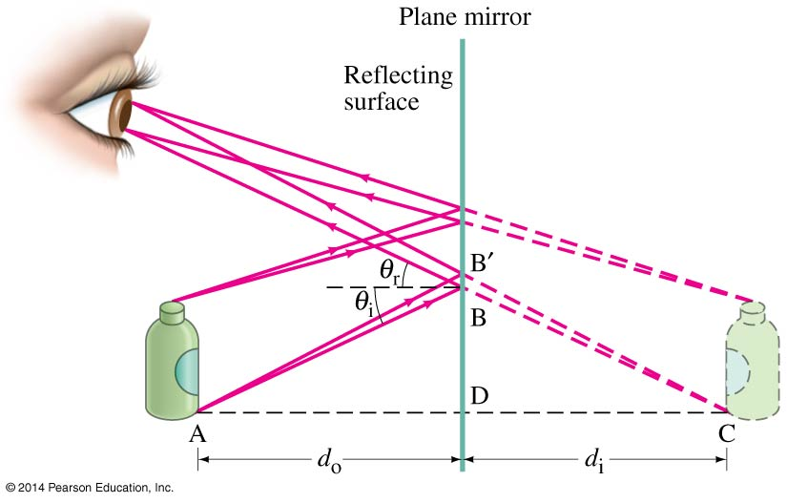
What you see when you look into a plane (flat) mirror is an image, i, which appears to be behind the mirror. This is called a virtual image.
Characteristics of Image Formed By A Plane Mirror
The image is same size as the object
The image is far behind the mirror as the object is in front
The image is virtual i.e. cannot be formed on a screen
The image is erect but laterally inverted

Slide 9
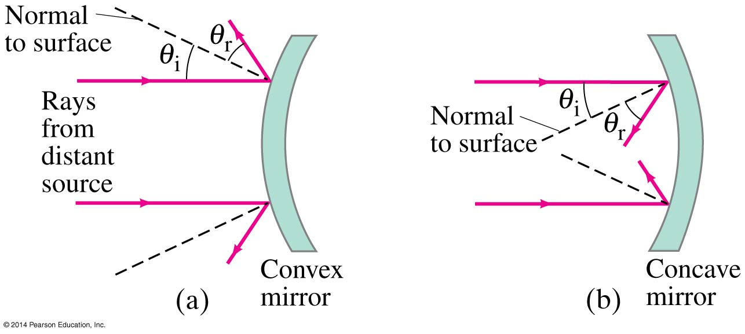
REFLECTION AT SPHERICAL (CURVED) MIRRORS
Spherical mirrors are shaped-like sections of a sphere, and may be reflective on either the inside (concave) or outside (convex). Concave Mirrors are mirrors that use the inside as reflecting surface while Convex mirrors use the outside as reflecting surface.

Slide 10
Basic Terms Related to Spherical Mirror
1. Principal axis: Line joining the pole and centre of curvature of the spherical mirror.
2. Pole: The geometrical central point of the reflecting spherical surface. (aperture), denoted by (P).
3. Aperture: The width of reflecting spherical surface.
4. Centre of curvature: The centre of the hollow glass sphere of which the spherical mirror is a part is called as centre of curvature.
5. Radius of curvature: The distance between the pole and the centre of curvature. i.e. PC = R or The radius of the hollow sphere of which the mirror is a part.
6. Focus point: The point on the principal axis, where all parallel rays meet after reflection is known as Principal Focus or Focus. It is denoted by letter ‘F’.
7. Focal length: The distance between the pole and focus point i.e. PF = f

Slide 11
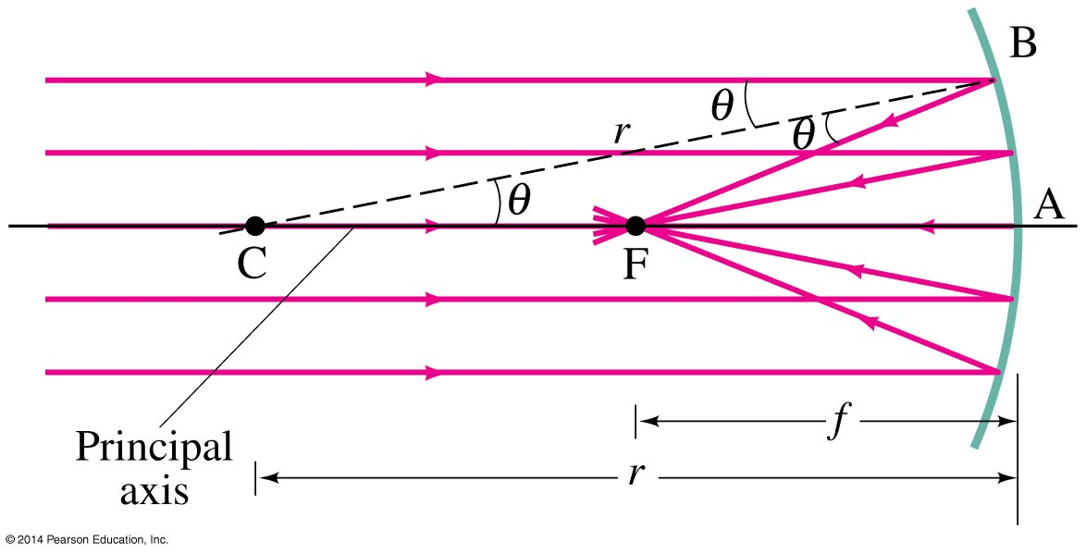
If the curvature is small, the focus is much more precise; the focal point is where the rays converge.
Using geometry, we find that the focal length is half the radius of curvature:

Slide 12
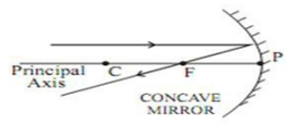
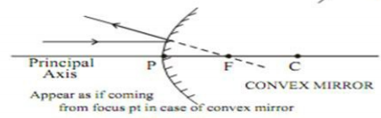
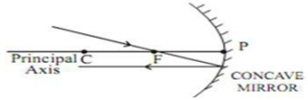
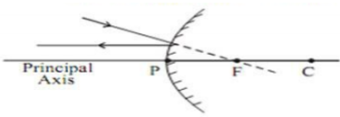
Formation of Images by Spherical Mirrors
We use ray diagrams to determine where an image will be
For mirrors, we use three key rays, all of which begin on the object:
A ray parallel to the axis; after reflection, passes through the focal point
2. A ray through the focal point; after reflection, is parallel to the axis

Slide 13
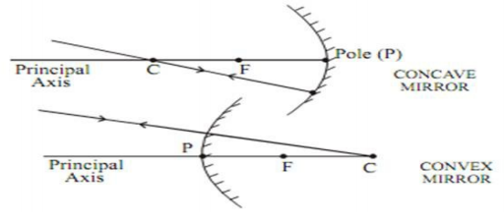
3. A ray of light which passes through the centre of curvature will retrace its path after reflection
Rules 1 to 3 are the basic Ray rules used in forming the location of the image formed by a concave or convex mirror

Slide 14
Image formed by Concave (converging) mirrors
The type of image produced by a concave mirror depends on the location of the object relative to the focal point and centre of curvature.
Real images are formed if the object is beyond the focal point.
In the ray diagrams in the next slide AB represents the Object while B¹A¹ represents the Image.

Slide 15
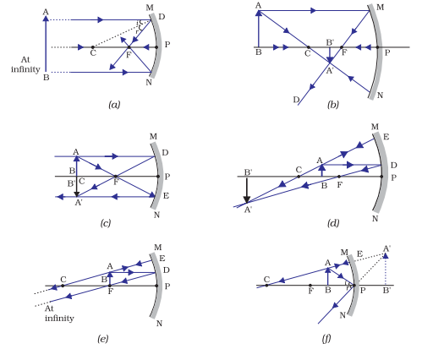
Image formed by Concave (converging) mirrors
Object at Infinity
Object beyond C
Object at C
Object b/w C and F
Object b/w F and P
Object at F

Slide 16
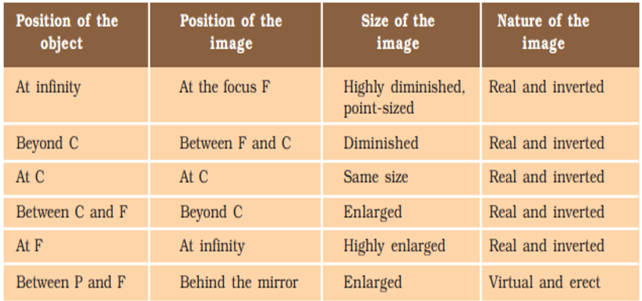
Characteristics of the image formed by a concave (Converging) Mirror

Slide 17
Uses of concave mirrors
Concave mirrors are commonly used in torches, search-lights and vehicles headlights to get powerful parallel beams of light.
2. They are often used as shaving mirrors to see a larger image of the face.
3. The dentists use concave mirrors to see large images of the teeth of
patients.
4. Large concave mirrors are used to concentrate sunlight to produce heat in
solar furnaces.

Slide 18
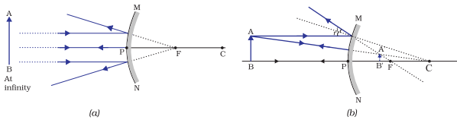
Image formation by a Convex Mirror
We consider two positions of the object for studying the image formed by a convex mirror. First is when the object is at infinity and the second position is when the object is at a finite distance from the mirror.
Object at Infinity
Object at any point of the mirror b/w infinity and the pole P
Characteristics of the image
Image formed at F
Highly diminished point-sized image
Image is virtual and erect
Image is formed on the other side of the mirror
Characteristics of the image
Image formed between P and F
Diminished image (Smaller than Object)
Image is virtual and erect
Image is formed on the other side of the mirror

Slide 19
Uses of convex mirrors
Convex mirrors are commonly used as rear-view (wing) mirrors in vehicles.
These mirrors are fitted on the sides of the vehicle, enabling the driver to see traffic behind him/her to facilitate safe driving.

Slide 20
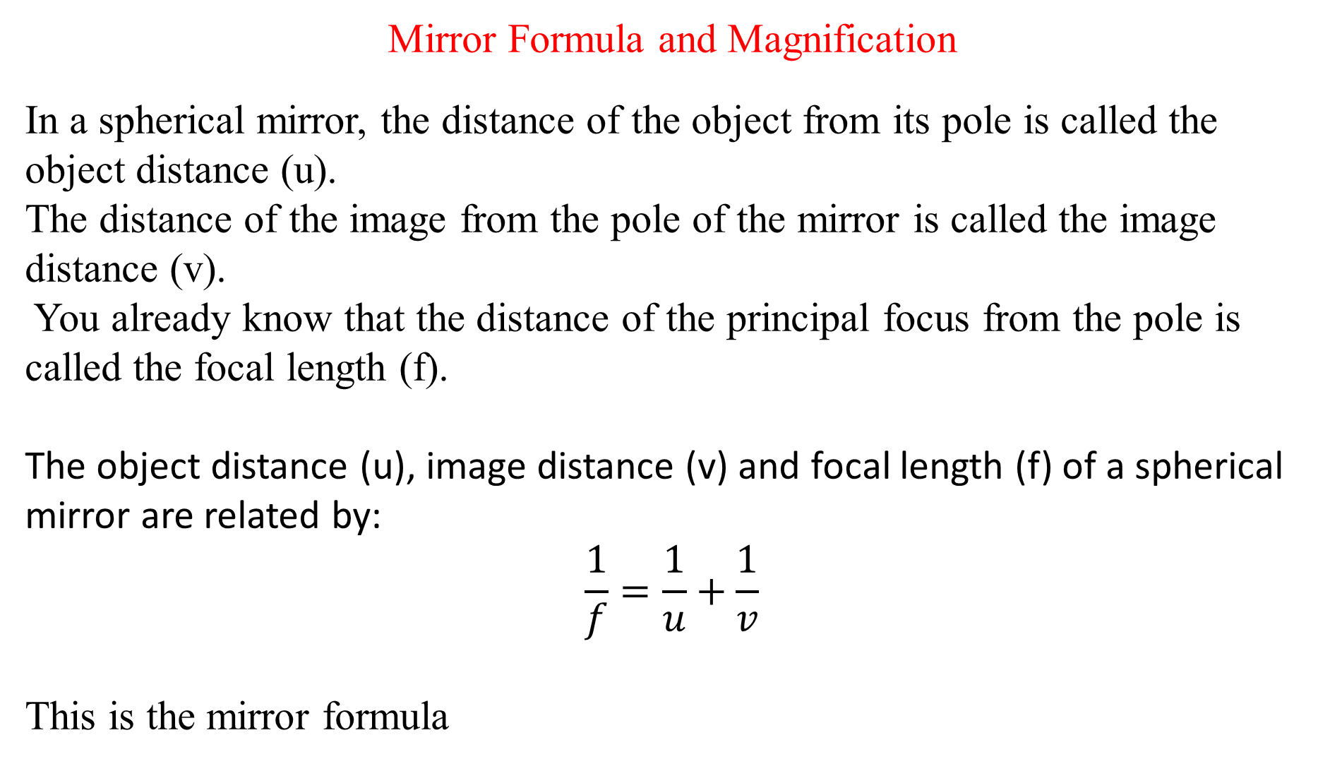
Mirror Formula and Magnification
In a spherical mirror, the distance of the object from its pole is called the object distance (u).
The distance of the image from the pole of the mirror is called the image distance (v).
You already know that the distance of the principal focus from the pole is called the focal length (f).
The object distance (u), image distance (v) and focal length (f) of a spherical mirror are related by:
$$\frac{1}{f}=\frac{1}{u}+\frac{1}{v}$$
This is the mirror formula

Slide 21
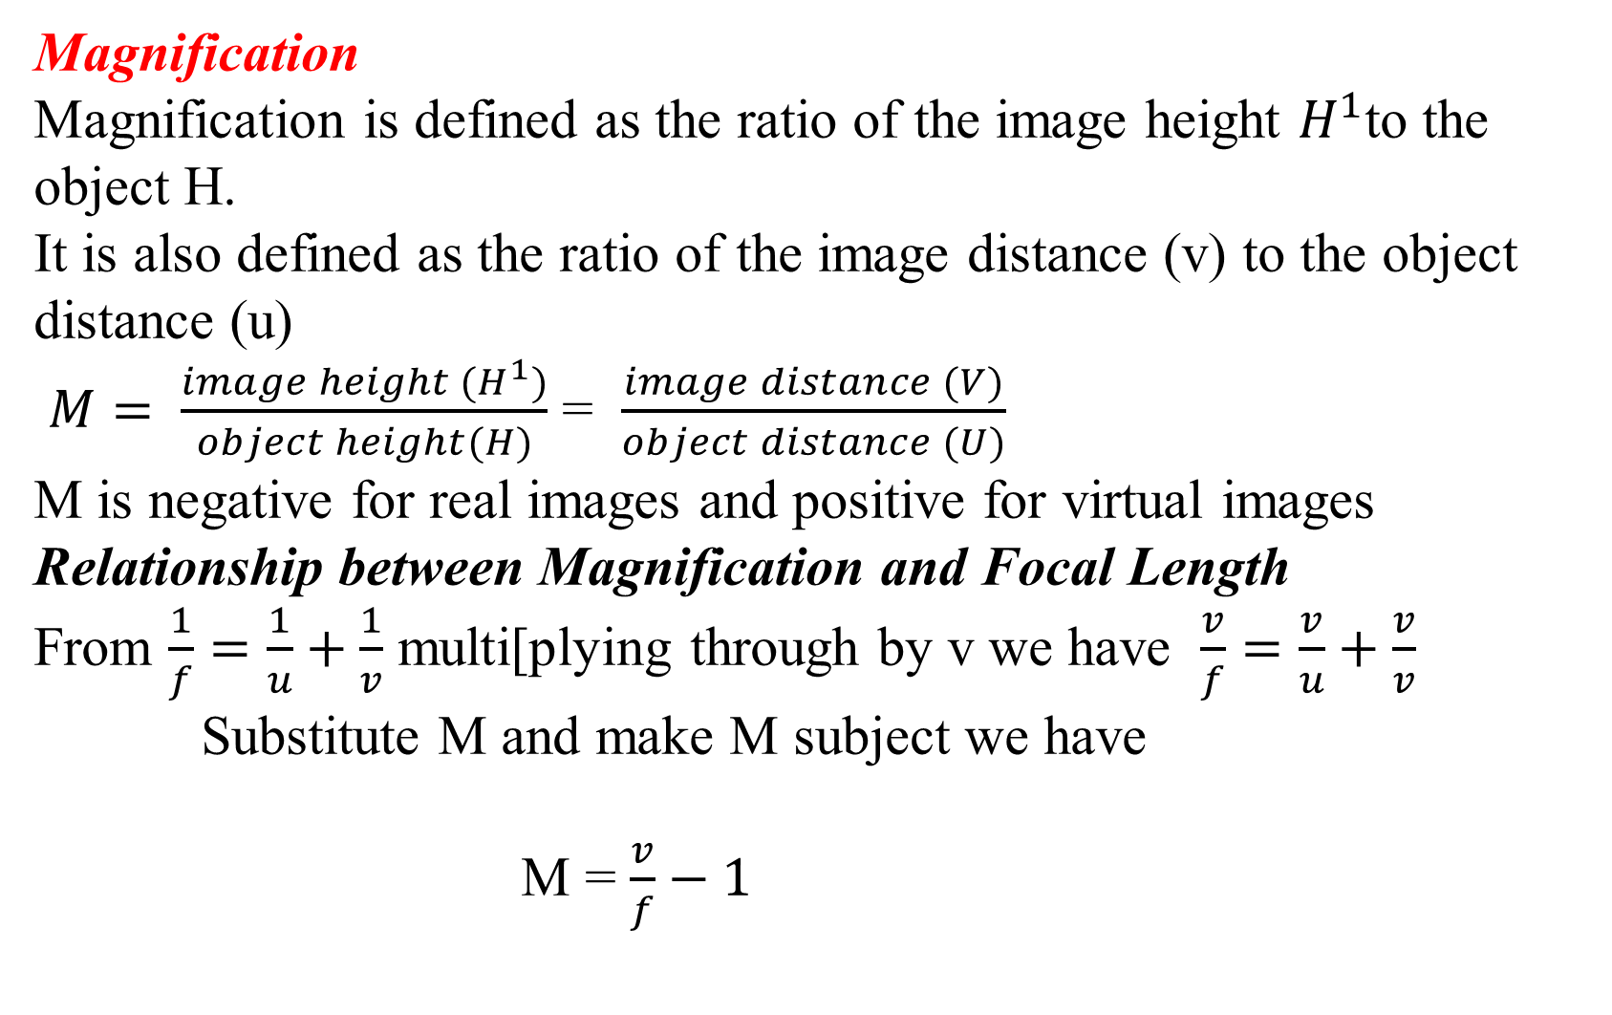
Magnification
Magnification is defined as the ratio of the image height $H^{1}$to the object H.
It is also defined as the ratio of the image distance (v) to the object distance (u)
$M= \frac{image height (H^{1})}{object height(H)}$ = $\frac{image distance (V)}{object distance (U)}$
M is negative for real images and positive for virtual images
Relationship between Magnification and Focal Length
From $\frac{1}{f}=\frac{1}{u}+\frac{1}{v}$ multi[plying through by v we have $\frac{v}{f}=\frac{v}{u}+\frac{v}{v}$
Substitute M and make M subject we have
M = $\frac{v}{f}−1$
M > 1 Image is magnified (bigger than object)
M = 1 image is same size as object
M < 1 image is diminished (smaller than object)

Slide 22
Example 1. A man uses a concave shaving mirror of radius 30 cm. If his face is 10 cm from the mirror, find (a) the position of his image, and (b) the magnification
Solution r = 30 cm, u = 10 cm
From 1/f = 1/v + 1/u
1/v = 2/r – 1/u = 2/30 – 1/10
= - 1/30, or v = - 30 cm ( the image is 30 cm behind the mirror)
(b) m = v/u = 30/10 = 3

Slide 23
Example 2. The image of an object in a convex mirror is 4 cm from the mirror. If the mirror has a radius of curvature of 24 cm, find the object position and the magnification.
Solution v = - 4 cm, f = - 12 cm
Substituting in 1/v + 1/u = 1/f
-1/4 + 1/u = -1/12
1/u = -1/12 + ¼ = 1/6
u = 6
Since u is positive in sign, the object is real, and it is 6 cm from the mirror.
Magnification, m = v/u = 4/6 = 2/3, and hence the image is two-thirds as high as the object.

Slide 24
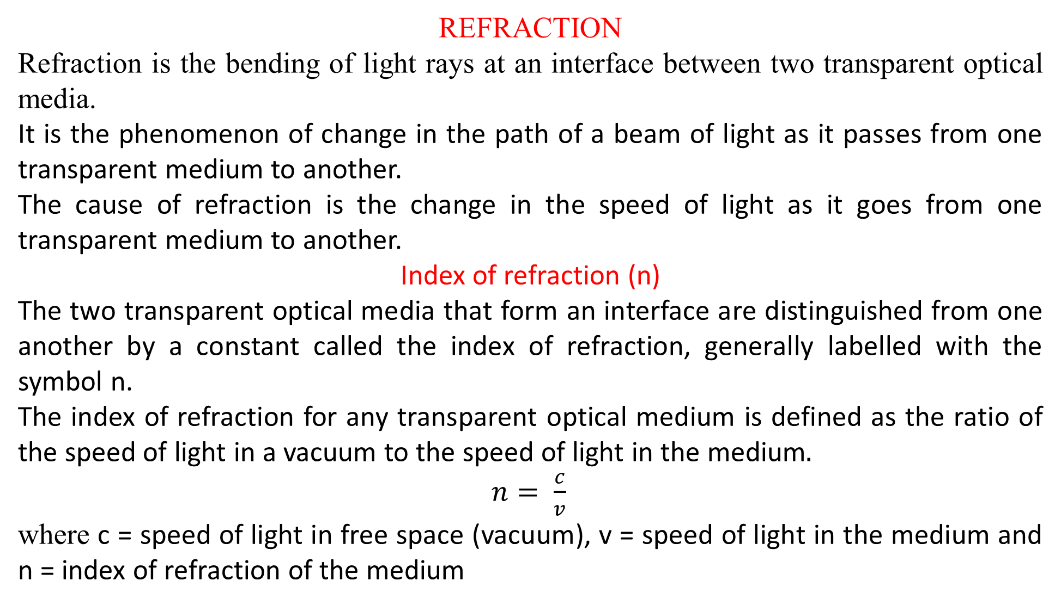
REFRACTION
Refraction is the bending of light rays at an interface between two transparent optical media.
It is the phenomenon of change in the path of a beam of light as it passes from one transparent medium to another.
The cause of refraction is the change in the speed of light as it goes from one transparent medium to another.
Index of refraction (n)
The two transparent optical media that form an interface are distinguished from one another by a constant called the index of refraction, generally labelled with the symbol n.
The index of refraction for any transparent optical medium is defined as the ratio of the speed of light in a vacuum to the speed of light in the medium$.$
$n= \frac{c}{v}$
where c = speed of light in free space (vacuum), v = speed of light in the medium and n = index of refraction of the medium

Slide 25
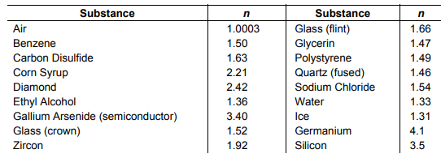
Indexes of Refraction for Various Materials
The greater the index of refraction of a medium, the lower the speed of light in that medium and the more light is bent in going from air into the medium.

Slide 26
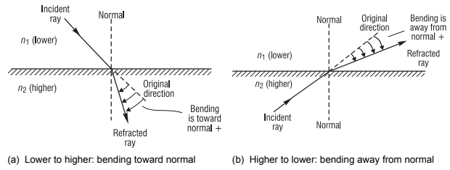
Refraction from different media
Refraction at an interface between media of refractive indexes n1 and n2
Note that in the first case (dense-to-denser) the light ray is bent toward the normal. In the second case (denser-to-dense) the light ray is bent away from the normal.

Slide 27
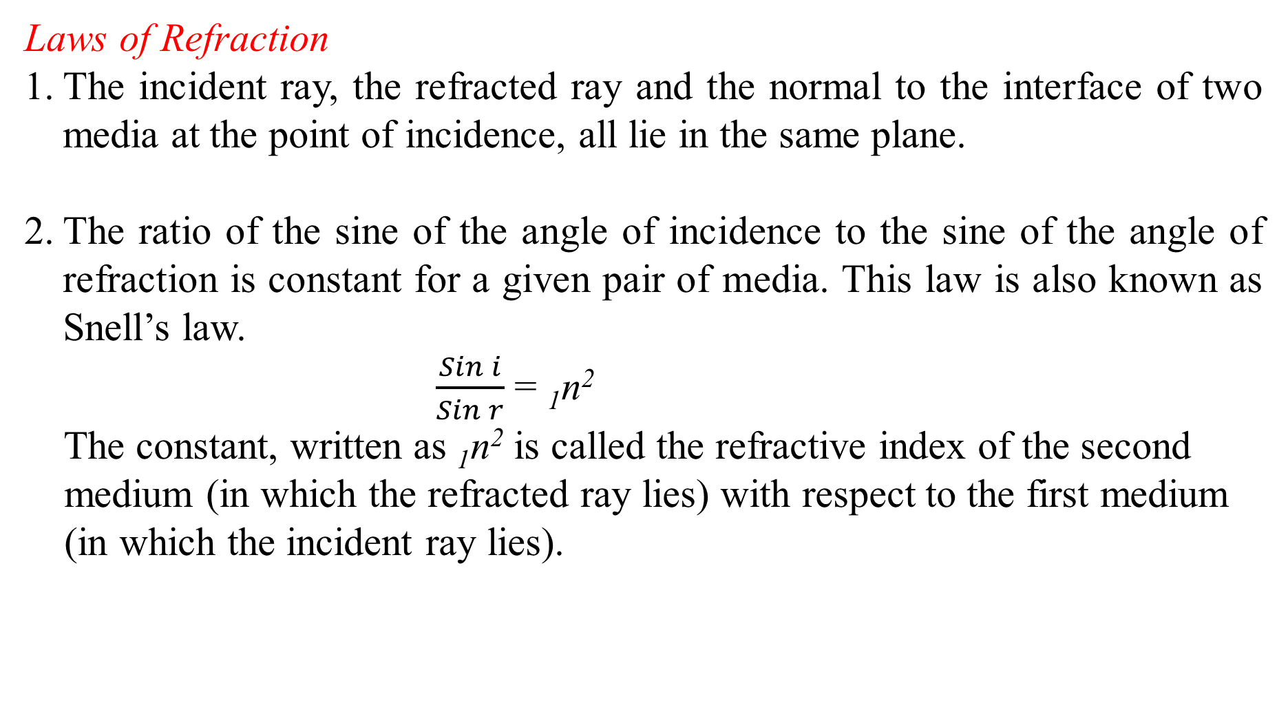
Laws of Refraction
The incident ray, the refracted ray and the normal to the interface of two media at the point of incidence, all lie in the same plane.
The ratio of the sine of the angle of incidence to the sine of the angle of refraction is constant for a given pair of media. This law is also known as Snell’s law.
$\frac{Sin i}{Sin r}$ = ₁n²
The constant, written as ₁n² is called the refractive index of the second
medium (in which the refracted ray lies) with respect to the first medium
(in which the incident ray lies).

Slide 28
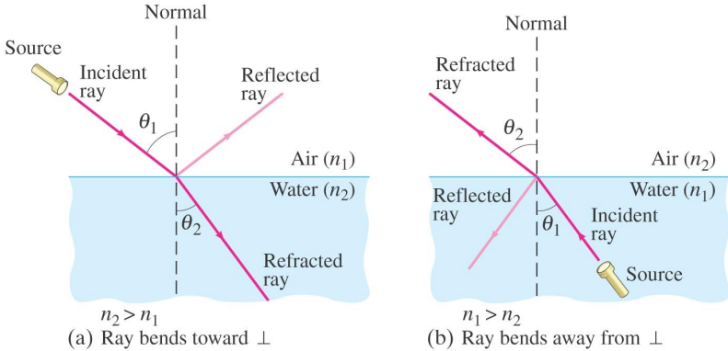
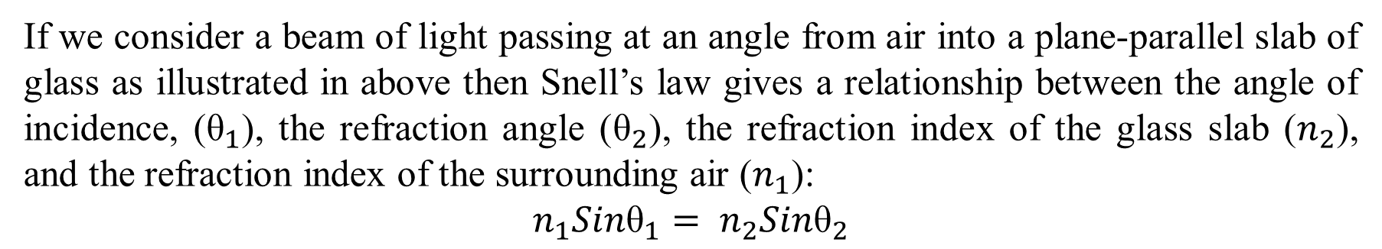
Refraction and Snell’s Law
If we consider a beam of light passing at an angle from air into a plane-parallel slab of glass as illustrated in above then Snell’s law gives a relationship between the angle of incidence, (${\text{θ}}_{1}$), the refraction angle (${\text{θ}}_{2}$), the refraction index of the glass slab ($n_{2}$), and the refraction index of the surrounding air ($n_{1}$):
$$n_{1}{Sin\text{θ}}_{1}= n_{2}{Sin\text{θ}}_{2}$$

Slide 29
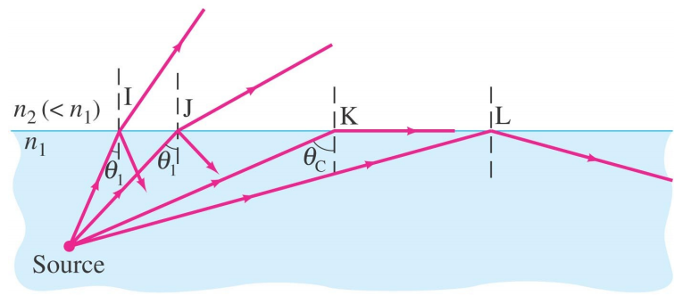
Total Internal Reflection and Critical angle
Total Internal reflection is the phenomenon that occurs when light travels from a denser medium to a less dense medium when the angle of incidence is greater than the critical angle.
The Critical angle is the angle of incidence for which the angle of refraction will be 90°

Slide 30
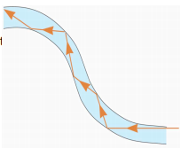
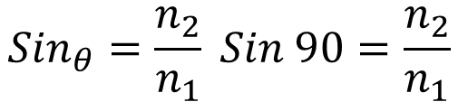
$${Sin}_{θ}=\frac{n_{2}}{n_{1}} Sin 90=\frac{n_{2}}{n_{1}}$$
If the angle of incidence is larger than this, no transmission occurs. This is called total internal reflection.
Conditions for total internal reflection to Occur
Light must be travelling from a denser to a less dense medium
The angle of incidence must be greater than the critical angle
Application of Total Internal Reflection;
1. Fibre Optics
Optical fibres also depend on total internal reflection; they are therefore able to transmit light signals with very small losses.
2. medical use of fibre optic cables for diagnosis and correction of medical problems
3.Telecommunications
Optical Fiber

Slide 31
Conditions for no refraction
When light is incident normally on a boundary.
When the refractive indices of the two media are equal.
Some Commonly observed phenomenon due to Refraction
1. Your eyes.
2. Rainbows.
3. Light bending in a glass of water.
4. Glasses.
5. Camera lenses.
6. Object dislocation in water.
7. Binoculars.
8. Total Internal Reflection

